Slide 1

BEST PRACTICES
Pager
Rotation
Duties
How it relates to the DevOps model
JACKIE SCOTT MODULE 7.2 9/16/24

Slide 2

What is pager rotation duty?
How does it relate to Devops?
Pager rotation is a practice of assigning specific people to be available at specific times to respond in the event of an urgent issue, even if this is outside normal business hours.
In DevOps, pager rotation duties ensure 24/7 service reliability with rapid response. It is vital for maintaining operational excellence. Pager rotation reinforces the DevOps principle of shared responsibilities for system performance and system uptime.

Slide 3
Importance of Best Practices for Pager Rotation
Best practices for pager rotation are crucial in ensuring that on-call duties are manageable and effective for your team. They play a vital role in preventing burnout by promoting a balanced workload and ensuring fairness. By implementing structured approaches, these practices help distribute responsibilities evenly, reduce stress, and maintain high levels of team morale. Some best practices include:
Defining Roles & Responsibilities
Define Escalation Plan
Automation and Alert Management
Build On-Call Culture and Communication
Keep Improving Best Practices

Slide 4
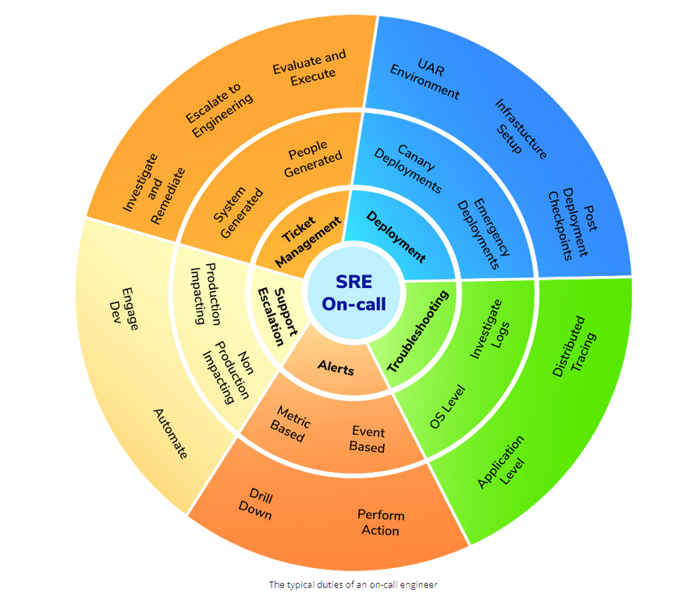
Defining Roles & Responsibilities
Primary vs Secondary On-call
Clear delineation of escalation channels and coverage.
Primary On-Call: This is the first responder to any incident. This person is responsible for either immediately resolving or escalating an issue.
Secondary On-Call: This person acts as a backup to the primary in case the primary is not available or needs assistance. This person ensures our DevOps principal of 24/7 coverage.
Ownership of Incidents
Links issues to the responsible party. By assigning the issue to a specific team member, we can have accountability. This helps with better tracking.
Knowledge Sharing & Documentation
Maintaining up-to-date documentation and ensuring all team members are trained properly. This will help reduce the number of errors and improve response efficiency.
Typical duties of on-call member

Slide 5
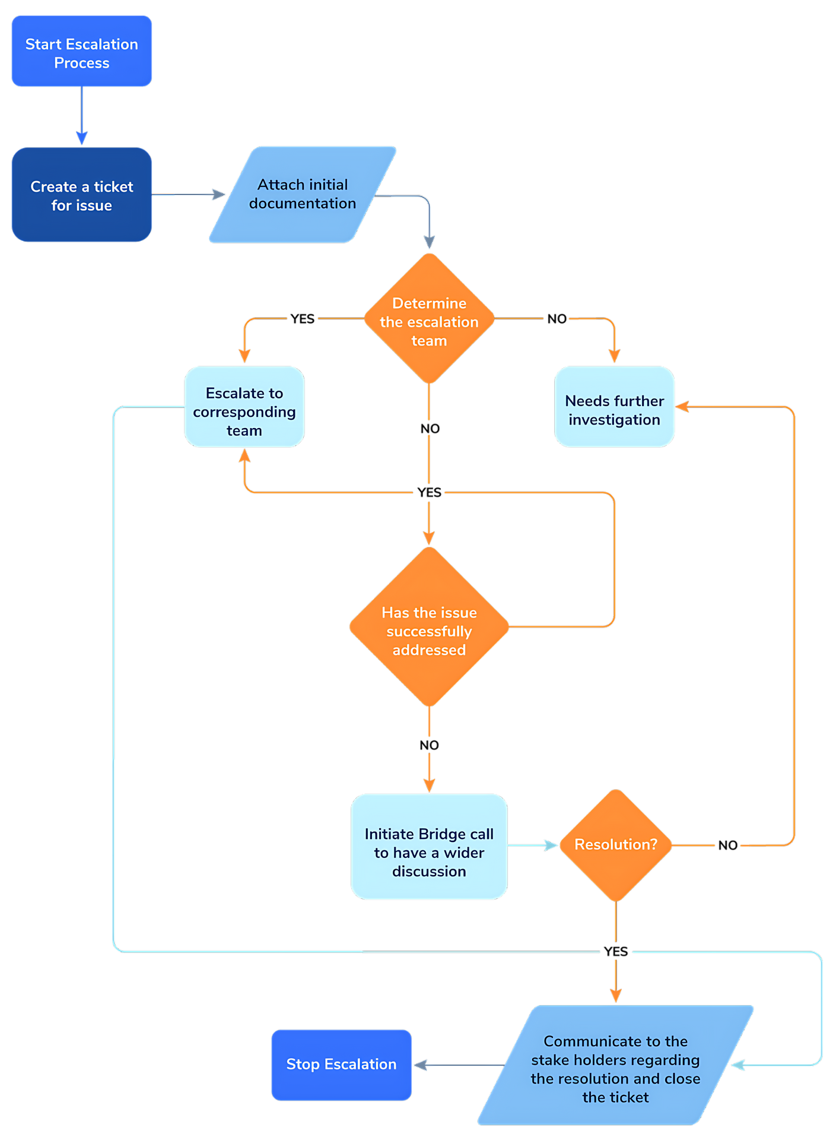
Design an Escalation Plan
Ticket Creation and Classification: For every issue, a ticket must be created containing comprehensive documentation, action items, and feature requests. Proper classification and assignment of tickets are crucial to reduce alert fatigue and ensure efficient resolution.
Importance of an Escalation Plan: An escalation plan streamlines incident management by routing tickets to the appropriate team or individual based on severity. It reduces downtime by ensuring prompt attention to critical issues, minimizes alert fatigue through balanced workload distribution, and enhances accountability with clear ownership and thorough documentation.
Best Practices: Implement automation for ticket classification and routing. Continuously review and refine the escalation process to maintain effectiveness and efficiency.

Slide 6
Automation & Alert Management
Incident Management Solutions
Personalizing Alerts
De-duplicating Alerts
Implementing tools like Jira Service Management to help automate workflows and detailed incident tracking.
By using a Service Management tool, incidents can be automatically assigned via workflows or business rules. This helps with quicker and more consistent responses.
Personalize alerts to mirror current urgency and incident types. Categorize either by urgency, impact, or area affected.
This will help ensure low-priority alerts are delayed until after business hours.
Reducing alert redundancy boosts response efficiency. De-duplicating consolidates multiple alerts from the same issue into one, preventing message overload.
If one down server triggers multiple monitoring tools, de-duplicating the alerts would make sure the on-call person would receive one consolidated alert vs multiple redundant alerts.

Slide 7
Build On-Call Culture & Communication
Blameless Culture
Promote a positive and learning-focused environment. Focus on conducting postmortem. This will help prioritize learning and improvements rather than assigning blame.
Regular Check-Ins
Gather feedback often from on-call team members to identify any area for improvement and adjust processes as needed. This ensures the on-call system is effective for the team's needs.
Empowering Teams
By building a supportive culture, regularly reviewing practices, and empowering team members, organizations can enhance their DevOps practices, leading to more efficient and resilient operations.
Involve on-call team members in the overall decision-making and process changes or improvements. This helps promote better solutions that, in return, increase job satisfaction.

Slide 8

Ways to Improve On-Call Roles
Hiring Process and Expectations: Evaluate candidates’ readiness for on-call duties during interviews.
Documented On-Call Plan: Transparent communication about responsibilities reassures potential hires.
Five Ways to Make On-Call More Developer-Friendly:
Clearly Define On-Call Responsibilities: Prevent burnout and confusion through clear documentation.
Assign Alerts to the Right Person: Fine-tune alerting tools for accurate notifications.
Primary and Secondary Responders: Backup plans for personal emergencies improve coverage.
Fine-tune schedules: Continuously review and adjust schedules for better work-life balance.
Tool Familiarity and Access: Ensure on-call engineers can access diagnostics and monitoring tools.

Slide 9

Works Cited
Atlassian. (n.d.-a). A manager’s guide to improving on-call. https://www.atlassian.com/incident-management/on-call/improving-on-call#you-built-it-you-maintain-it
Atlassian. (n.d.-b). How to run a blameless postmortem. https://www.atlassian.com/incident-management/postmortem/blameless
Atlassian. (n.d.-b). Pros and cons of different approaches to on-call management. https://www.atlassian.com/incident-management/on-call
On-call rotation : Tutorial & best practices. On-Call Rotations and Schedules: Tutorial & Best Practices. (n.d.). https://www.squadcast.com/sre-best-practices/on-call-rotation

Slide 10

Thank You

